Slide 1


Industrial Grade
Dynamic
Laboratory Auto-Titrator
Not just a project. It’s a potential Product.
20BEC1155

Slide 2

TOC
Title of the Project
About
Introducing the Concept.
Why this project is important
Novelty analysis
Methodology – Work Flow
Block diagram And Components
Timeline
Q and A / Notes for next Review

Slide 3
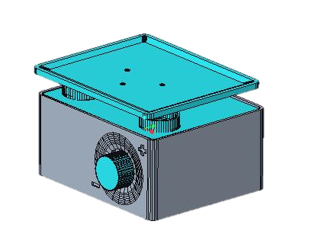
About
Thirumalai Srinivasan G
Reg No : 20BEC1155
Batch : 14
Mail id : thirumalaisrinivasan.g2020@vitstudent.ac.in
Department : ECE
Work Experience :
Multi-Disciplinary Engineer, VLogInnovations LLP
Platform Developer, EngineeringMonk
Portfolio Site : www.iamthiru.com
Recent Achievements :
HCL HACK IIT Kanpur Jury Winner – International Round
Exhibited Couple of robots at National CBSE EXPO
Part of Nidhiprayas Funded (DST) Project
in collaboration with ICMR.

Slide 4

Who am I?
Thirumalai Srinivasan G
B.Tech. ECE – VIT Chennai
Experience & Skill
An Industrious Design Engineer with 3+ years of experience as Inter-Disciplinary Engineer at Vloginnovations LLP. ,aiming at building innovative rather impressive inventions cardinally careened around Complex codes and delicate Electronics with personal ethics of holding reputation for on-time project completion and with a significantly positive slope in my learning curve and striving to increase it's curvature.
Been part of 50+ innovative projects.
Been part of 5+ industrial projects including Medical grade projects .(India,Usa)
Been part of a DST funded Project – PhotonMax532 (A product of VLogInnovations LLP in collab. With NIRT, ICMR and BiRD Lab, IIITDM Kancheepuram)

Slide 5
Industrial Grade
Dynamic
Laboratory Auto-Titrator
Not just a project. It is a potential Product.
20BEC1155

Slide 6
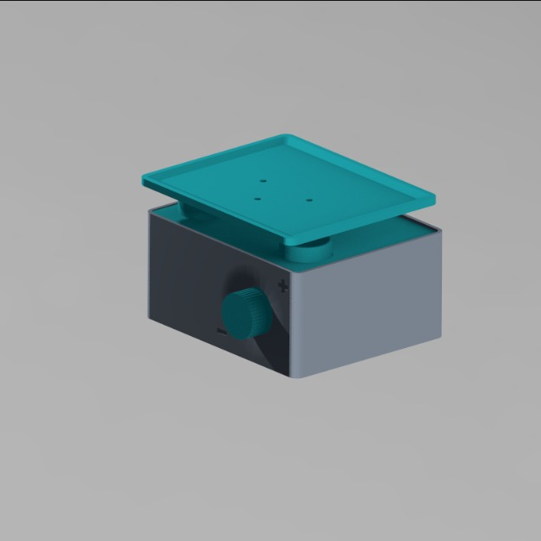
About the Project,
Auto – Titrator - Objective
The Project is an Automatic Rocker eco-system based on 8051 and other peripherals for continuos titration in Laboratory for enhanced hygine and accurcy.
Key Features
A product is constructed to be used in our LABORATORY
Product quality, Self Designed Case structure for durablity
Minimal and Trustworthy Electronics to ensure mere failsafe technology.
Embedded Conditions monitoring System to ensure perfect nature of activity ( less anti reactions in the chemicals)
Can also be used as LAB rocker machine – eg ( BLOOD sample bag)
20BEC1155 – Thirumalai Srinivasan G

Slide 7
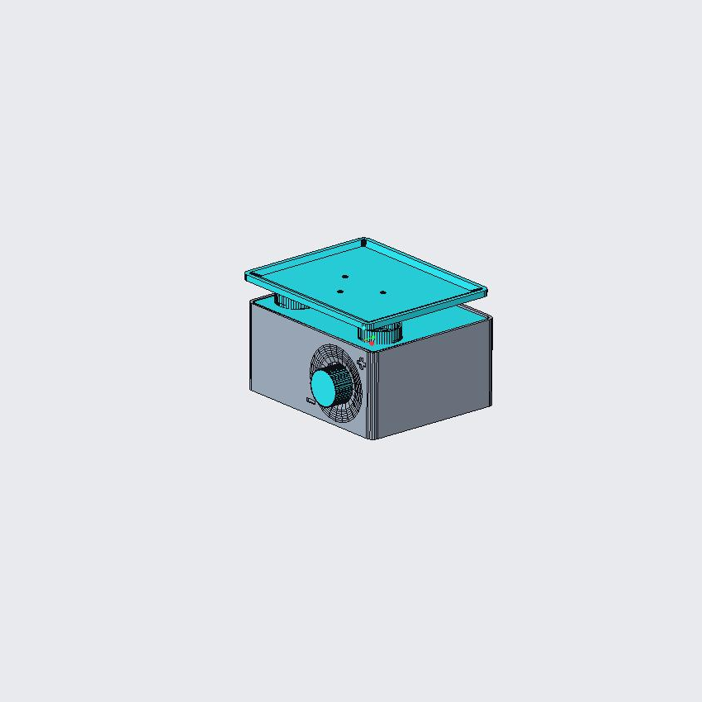

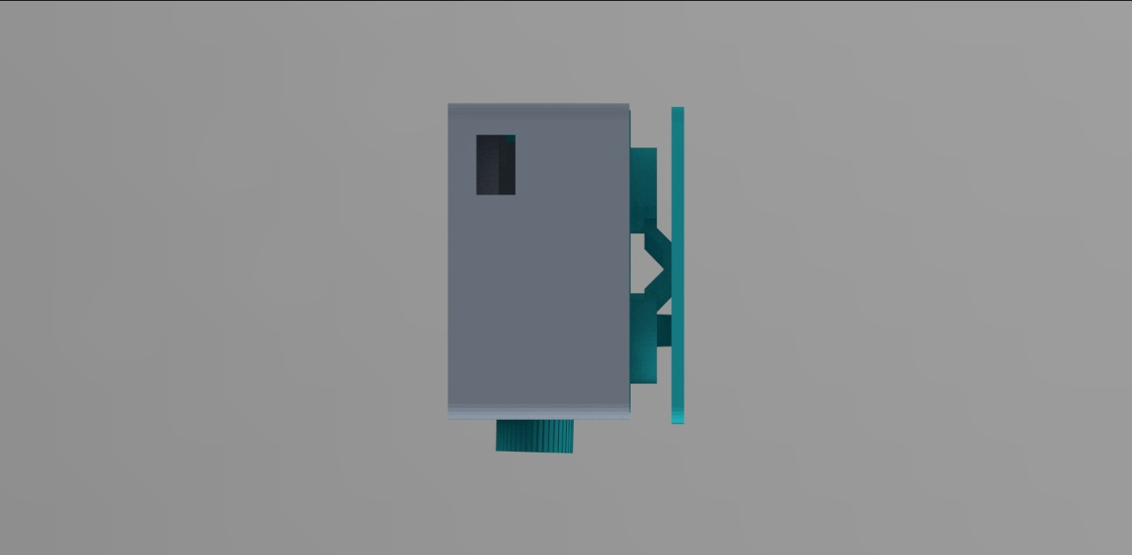
About Us,
Why is this IMPORTANT?
This is going to be used in the company called Vloginnovations LLP as we are into Products including Drug Susceptibility Testing Equipments funded by DST,
NIDHIPRAYAS grant. (In Collaboration with NIRT, ICMR )
We required an automatic LAB-rocker with temperature control.
As there is no restriction on the SOC, I have opted that product to be presented as Project using 8051 and ensuring submission of an industrial grade Product prototype.

Slide 8
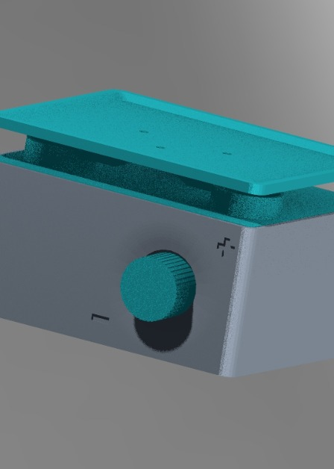
About Us,
FLOW OF WORK
Methodology, Our Primary Work flow
01
Fixing up With the Hardware
Once there is no issues with proposed Hardware with the subject norms, we are good to go
02
Preparing the STL files
STL files will be sliced for building the prototype
03
Building Electronics of Prototype
Prototype will be built using Dot board and further designed to build A industrial grade PCB.
04
Final Debugging and Finishing up
Our motive is making Industrial grade pcb. Custom made.

Slide 9
Components
8051 - Microcontroller
Motor driver IC - L293D
Temperature monitoring Module
Temperature Module
Display interface –
LCD - 8 + 3 Pins
Stepper Motor – 1.7 A – 4.2KG
Custom Built 3d Body
Ball bearings and Screws
IOT engine
7805 5v regulator

Slide 10
OLED / LCD
BLOCK Diagram
8051
Stepper Motor
L293D
Temperature
Module
IOT Engine
ESP01
Wifi Module

Slide 11
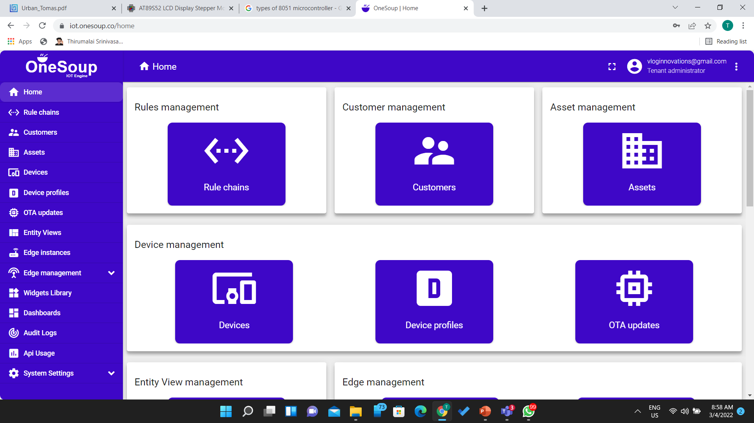
IOT ENGINE

Slide 12
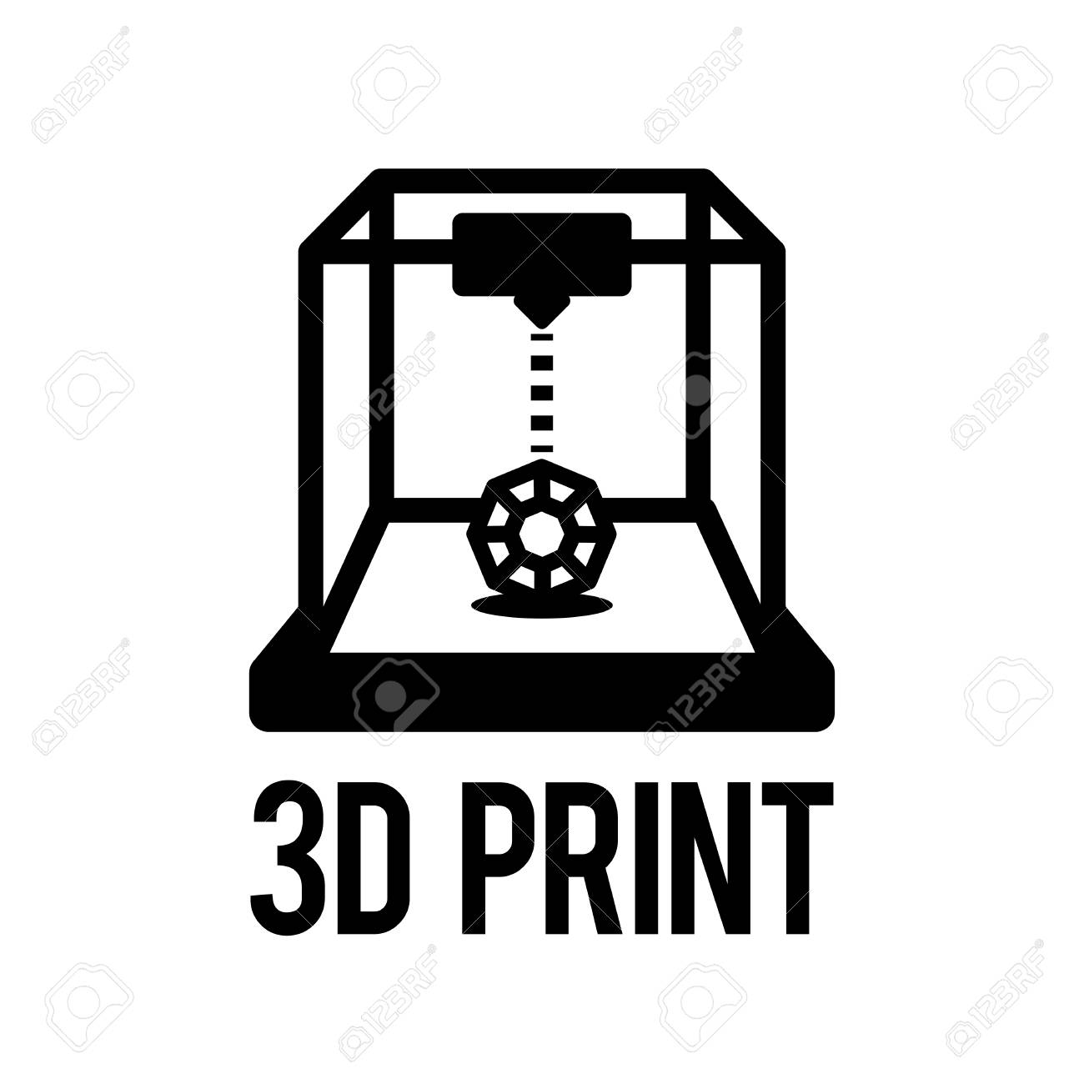


After this Review
2nd Review - POC
Complete Product
These Timeline may vary according to the R and D factor.
Production of Designed Mechanical parts.
Setting up IOT engine
Submission of primitive Working Circuits and 3D printed cases
Submission of Complete, usable and mere fail safe product.
About Us,
Tentative
Timeline
This is a usecase product rather than just a Namesake project. We are making this exclusively for our labwork.

Slide 13
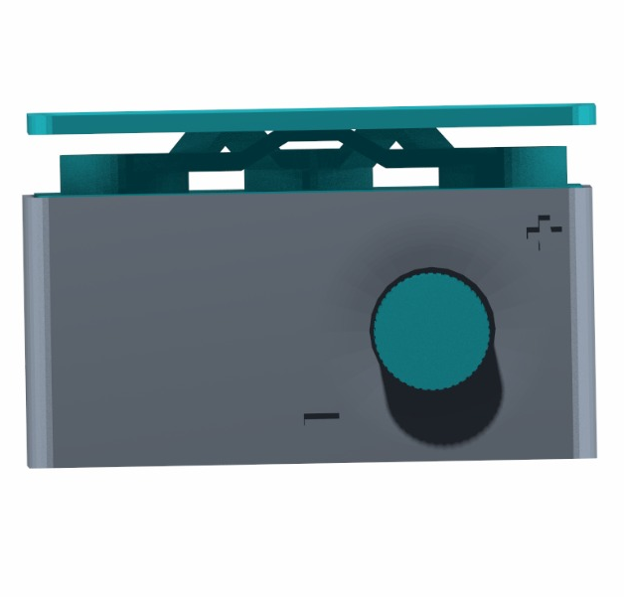
EXPECTED OUTPUT
MINIMAL INDUSTRIAL GRADE AUTO-TITRATOR
Positively Connected to IOT engine.

Slide 14
PROOF OF CONCEPTS

Slide 15
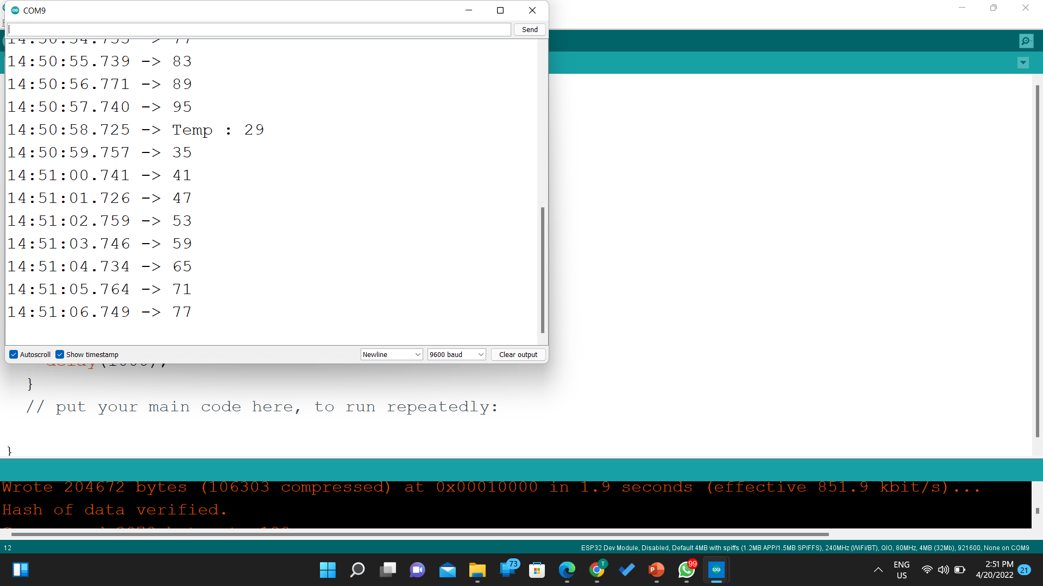

Slide 16
3D STL files
We have Designed 3D files and sliced them into respectively and started our works

Slide 17
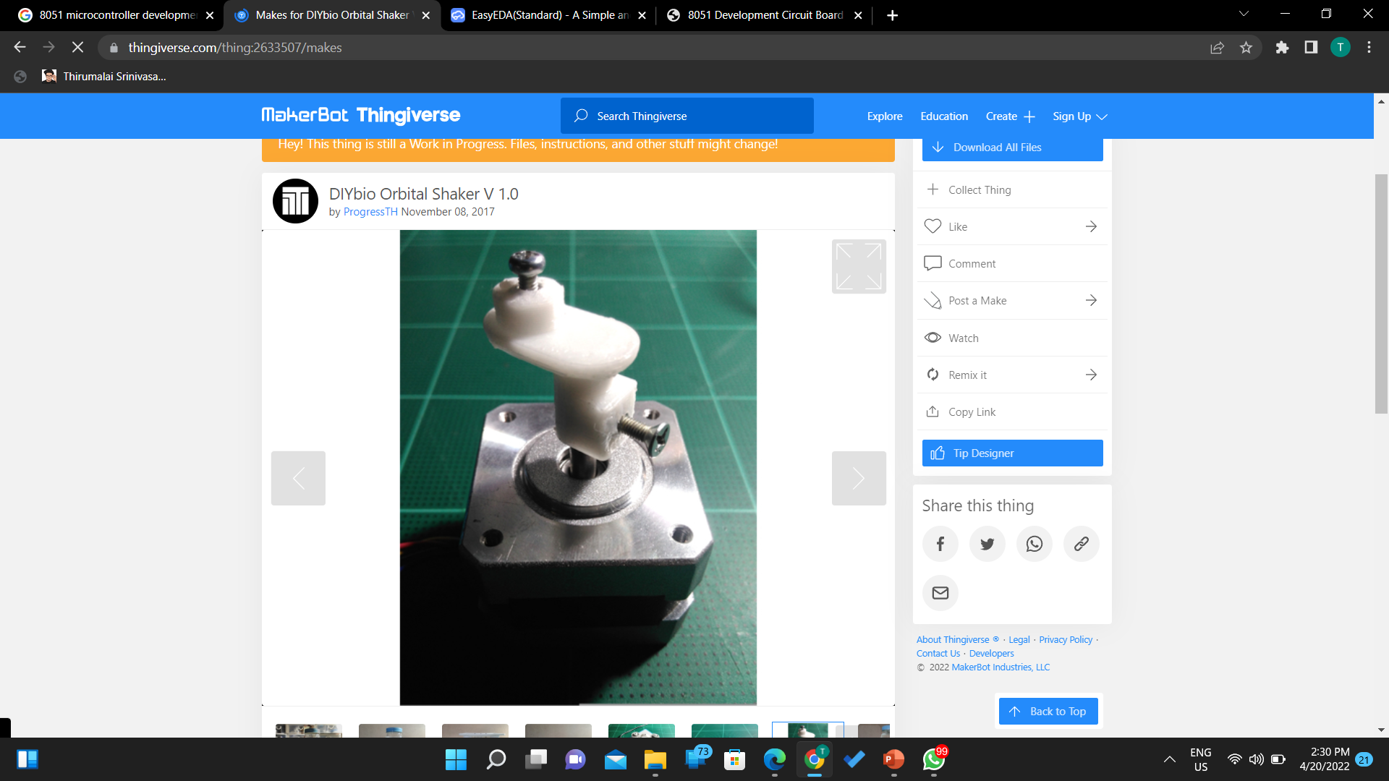
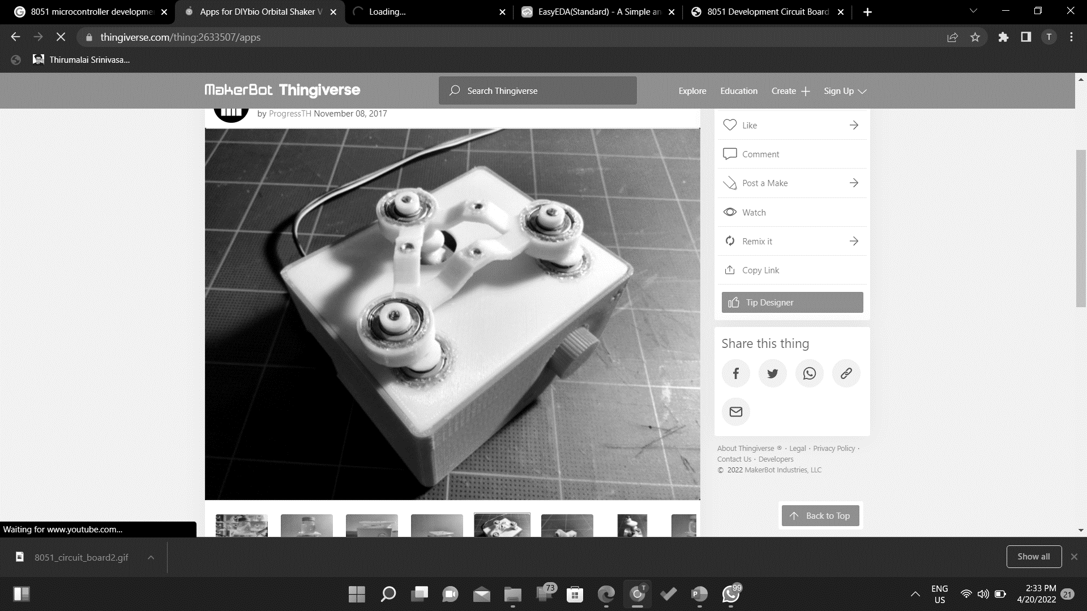
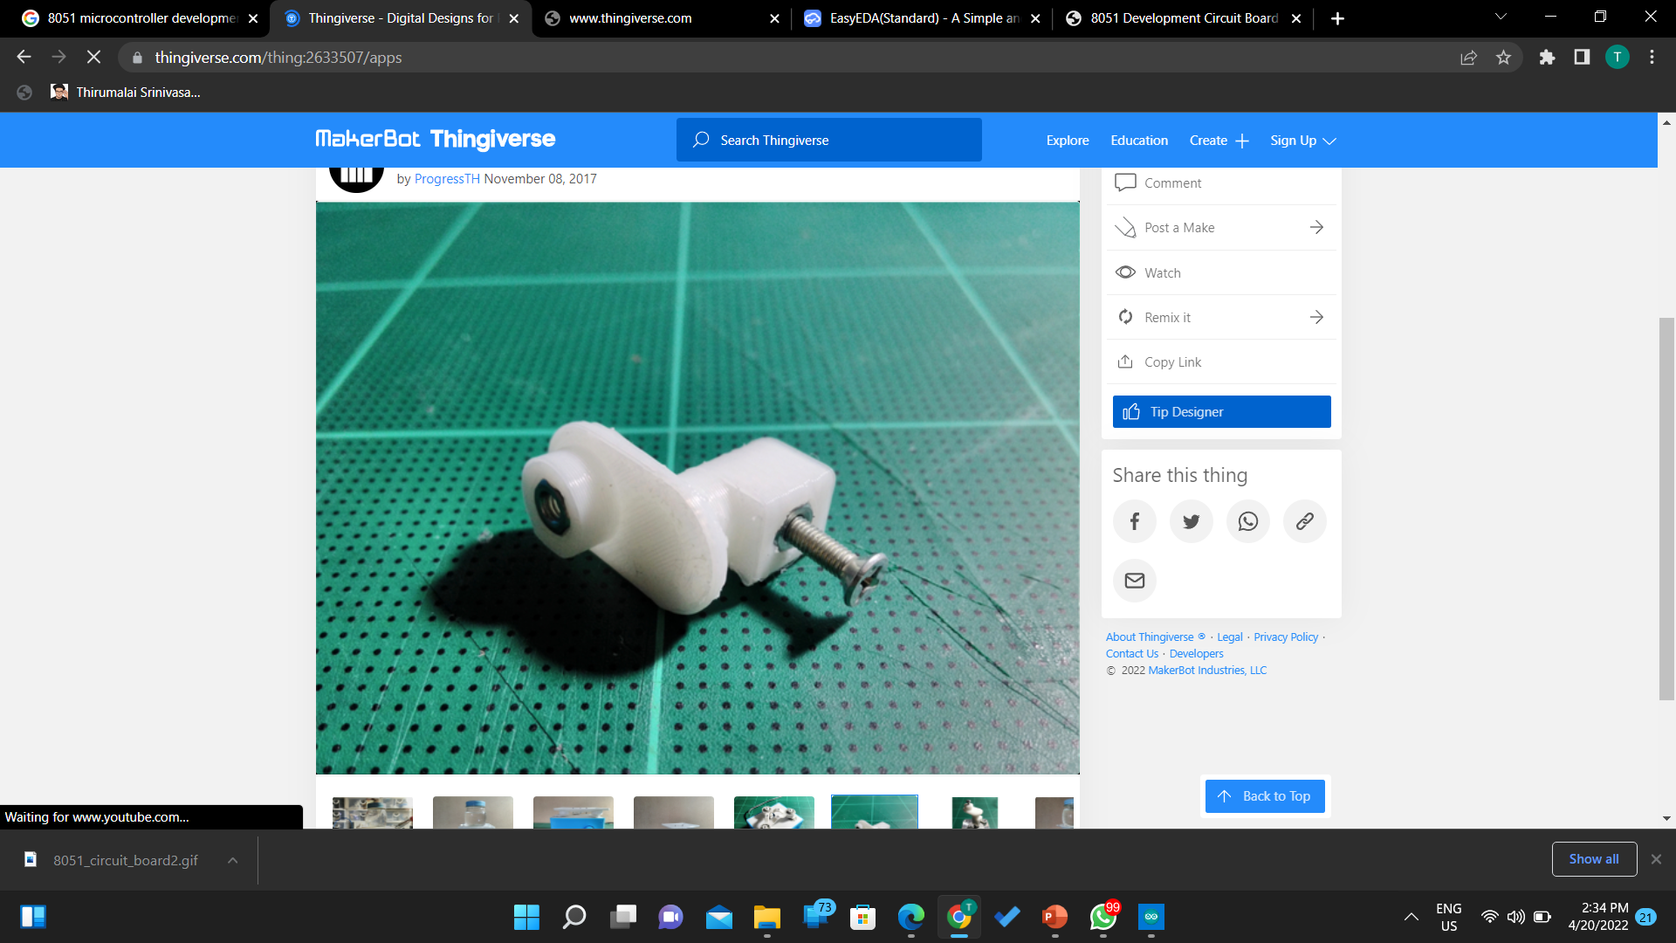
Design and Fixing

Slide 18
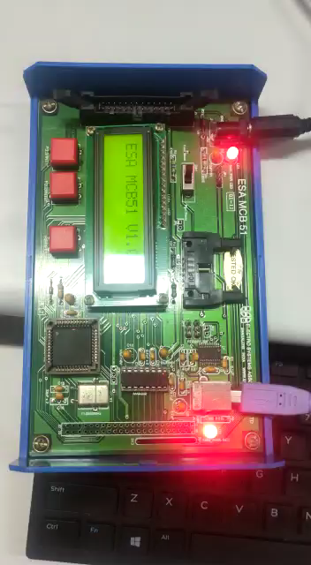
LCD interfacing

Slide 19
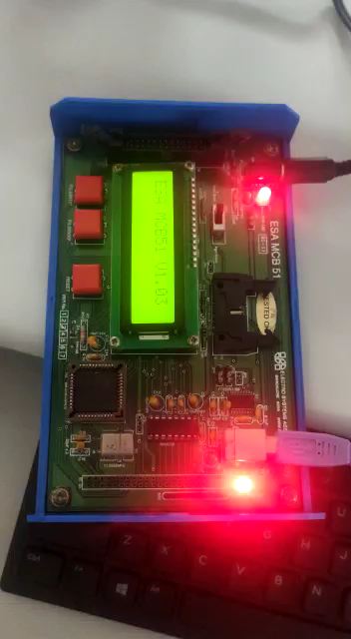

Slide 20
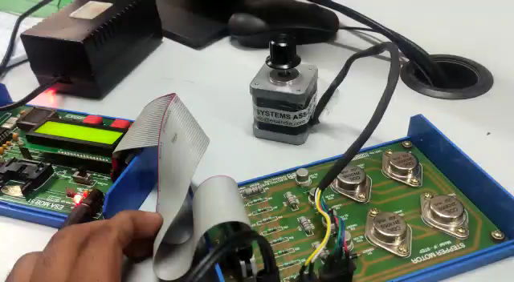
Stepper Motor Interfacing

Slide 21
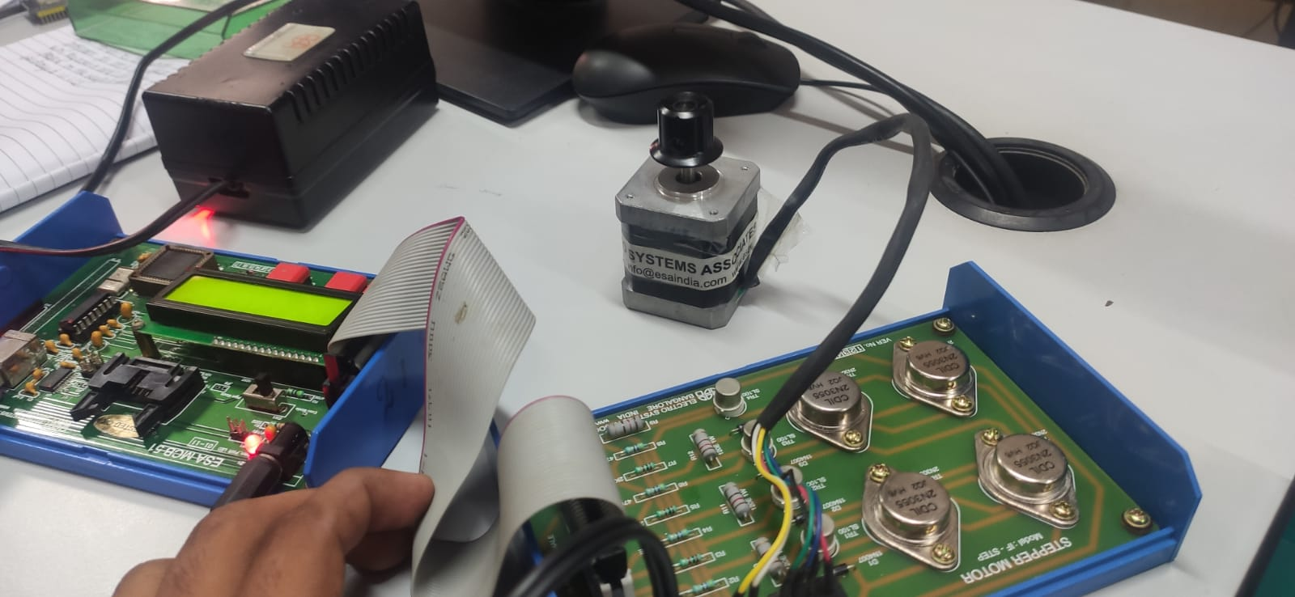

Slide 22
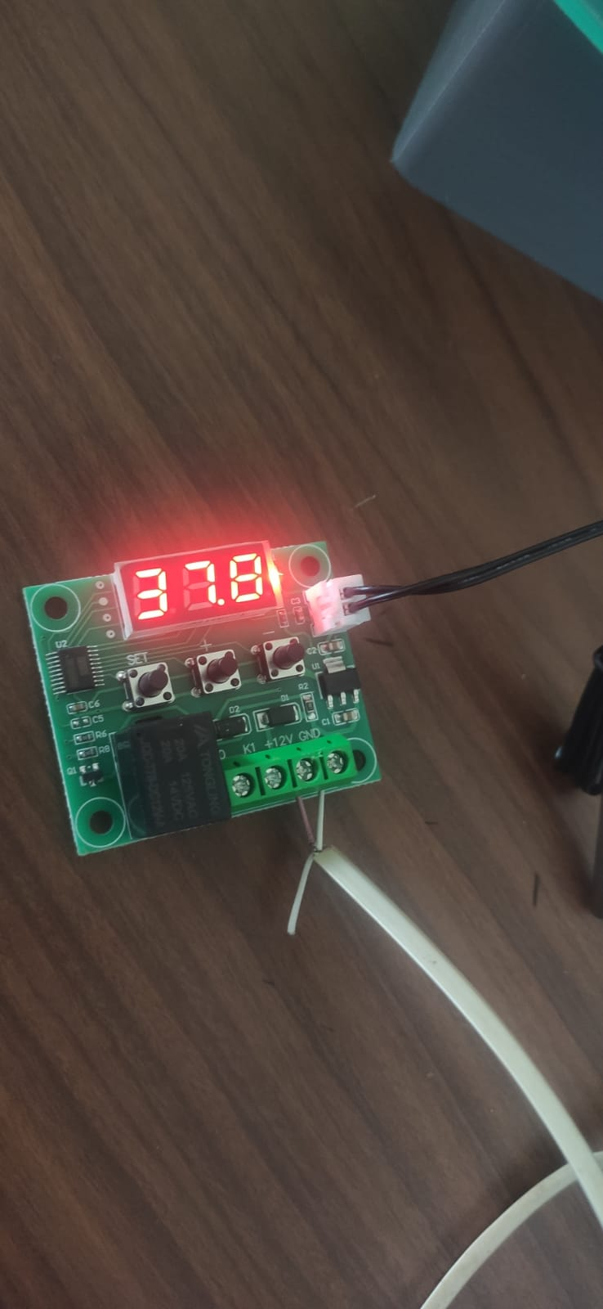
Temperature Module W1209
Temperature Module W1209

Slide 23
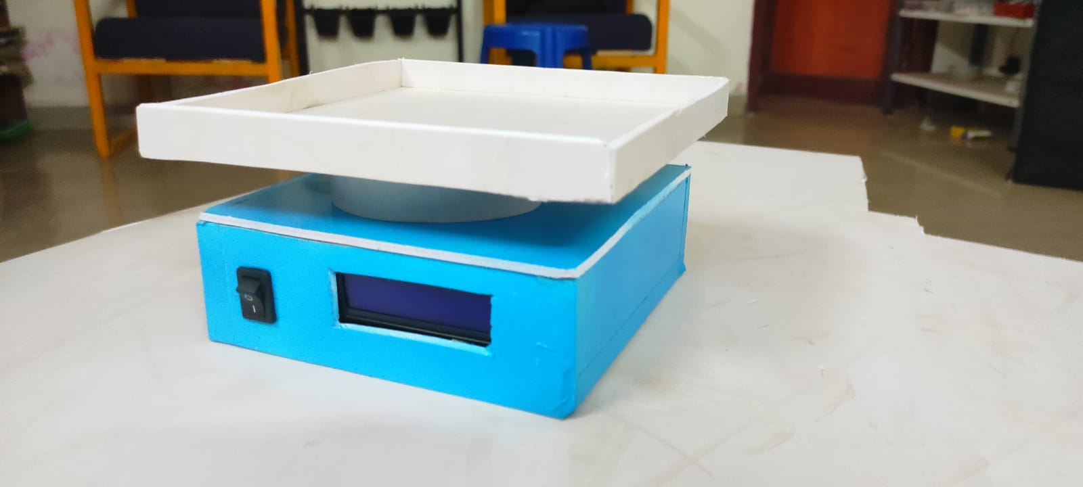
Acrylic Foam Board Prototype

Slide 24
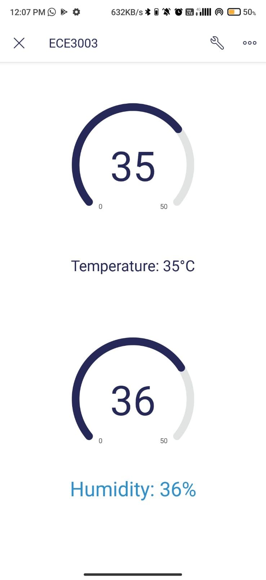
IOT OUTPUT

Slide 25

Contact us
Contact Us,
Keep in Touch
Thirumalai Srinivasan G
1 V.V. Giri st, Devi nagar, annanur, Chennai
Phone Contact
+91 9790761391
Email Contact
@thirug2k02@gmail.com
@thirumalaisrinivasan.g2020@vitstudent.ac.in

Slide 26

Thank you for listening
This project is a tribute to all the frontline workers who worked hard during pandemic and still continuing to.

